Slide 1
Algorithms and Data Structure II §3 Graphs, Definitions and Representations
https://elms.u-aizu.ac.jp/course/view.php?id=4362
Yuichi Yaguchi, Ph.D (CSE)
Robot Engineering Lab., University of Aizu

Slide 2
Chap. 1 Definition of the Graph Structure
§3 Graphs, Definitions and Representations

Slide 3
Graphs, Definitions and Representations
A graph G(V, E) consists of a set of vertices (nodes) V and a set of edges E.
If the edges are ordered pairs (v, w) of vertices then the graph is directed (edges are also called arcs)
b
c
a
d
f
e

Slide 4
Graphs, Definitions and Representations
A graph G(V, E) consists of a set of vertices (nodes) V and a set of edges E.
If the edges are unordered pairs (v, w) of vertices then the graph is undirected.
b
c
a
d
f
e

Slide 5
Adjacent
In a directed graph G(V, E), if (v, w) is an edge in E then:
we say vertex w is adjacent to v.
We also say edge (v, w) is from v to w.
The number of vertices adjacent to v is the (out-) degree of v.
In an undirected graph G(V, E),
(v, w) and (w, v) are the same edge.
w is adjacent to v if (v, w) is in E.
The degree of a vertex is the number of vertices adjacent to it.
We say the edge (v, w) is incident on v.

Slide 6
Path and Cycle
A path in a graph is a sequence of edges of the form (v₁,v₂), (v₂,v₃), ..., (v_{n-1},v_{n}). The path is from v₁ to v_{n} of length n-1.
As a special case, a single vertex denotes a path of length 0 from itself to itself.
A path is simple if all edges and all vertices on the path, except possibly the first and the last vertices, are distinct.
A cycle is a simple path of length at least 1 which begins and ends at the same vertex. In an undirected graph, a cycle must be of length at least 3.
b
c
b
c
a
Simple
d
a
Cycle
d
f
e
f
e

Slide 7
Adjacency Matrix
One of the common representations for a graph G(V, E) is the adjacency matrix, a |V|×|V| matrix A of 0's and 1's, where A[i,j] = 1 if there is an edge from vertex i to vertex j.
The adjacency matrix requires O(|V|²) memory space for graph G(V, E) .
Directed Graph
 | a | b | c | d | e | f
a | 0 | 1 | 1 | 0 | 0 | 1
b | 1 | 0 | 0 | 0 | 0 | 1
c | 0 | 1 | 0 | 0 | 1 | 1
d | 0 | 0 | 1 | 0 | 1 | 0
e | 0 | 1 | 0 | 0 | 0 | 0
f | 0 | 0 | 0 | 0 | 1 | 0
b
c
a
d
f
e

Slide 8
Adjacency Matrix
One of the common representations for a graph G(V, E) is the adjacency matrix, a |V|×|V| matrix A of 0's and 1's, where A[i,j] = 1 if there is an edge from vertex i to vertex j.
The adjacency matrix requires O(|V|²) memory space for graph G(V, E) .
Undirected Graph
 | a | b | c | d | e | f
a | 0 | 1 | 1 | 0 | 0 | 1
b | 1 | 0 | 1 | 0 | 1 | 1
c | 1 | 1 | 0 | 1 | 1 | 1
d | 0 | 0 | 1 | 0 | 1 | 0
e | 0 | 1 | 1 | 1 | 0 | 1
f | 1 | 1 | 1 | 0 | 1 | 0
b
c
a
d
f
e

Slide 9
Adjacency List
An adjacent list for a vertex is a list of all vertices adjacent to it. A graph can be represented by |V| adjacency lists, one for each vertex.
Adjacency lists require O(|V|+|E|) memory space for graph G(V, E).
Adjacency lists are often used for sparse graph G(V, E) with |E| << n².
Note that |E| ≤ |V|(|V|-1) for directed graph.
Directed Graph
a | →b | →c | →f
b | →a | →f
c | →b | →e | →f
d | →c | →e
e | →b
f | →e
b
c
a
d
f
e

Slide 10
Adjacency List
An adjacent list for a vertex is a list of all vertices adjacent to it. A graph can be represented by |V| adjacency lists, one for each vertex.
Adjacency lists require O(|V|+|E|) memory space for graph G(V, E).
Adjacency lists are often used for sparse graph G(V, E) with |E| << n².
Note that |E| ≤ [(|V|(|V|-1))/2] for undirected graph.
Undirected Graph
a | →b | →c | →f
b | →a | →c | →e | →f
c | →a | →b | →d | →e | →f
d | →c | →e
e | →b | →c | →f
f | →a | →b | →c | →e
b
c
a
d
f
e

Slide 11
Chapter 1. Quiz
Please illustrate a directed graph from adjacency matrix
Please illustrate an adjacency list from above graph
 | a | b | c | d | e | f
a | 0 | 0 | 0 | 1 | 0 | 1
b | 1 | 0 | 1 | 1 | 0 | 1
c | 1 | 1 | 0 | 0 | 0 | 1
d | 1 | 0 | 1 | 0 | 1 | 0
e | 0 | 0 | 1 | 0 | 0 | 1
f | 1 | 0 | 1 | 0 | 0 | 0

Slide 12
Chap. 2 Depth-First Search
§3 Graphs, Definitions and Representations

Slide 13
Depth-First Search
Depth-first search (DFS) is a natural way to “visit” every vertex and check every edge in the graph systematically.
It has applications for many graph problems, such as checking the connectivity, finding the connected components or cycles, and so on, in graphs.
DFS is continue searching in the forward (deeper) direction as long as possible.

Slide 14
Depth-First Search
Select a vertex v and visit v. (v is also called the root of the DFS search tree.)
Then select any edge (v,w) incident on v and visit w.
In general, suppose x is the most recently visited vertex. The search is continued by selecting some unexplored edge (x,y) incident to x.
v
g
f
v
g
f
w
x
w
x
d
c
e
d
c
e

Slide 15
Depth-First Search
If y has been previously visited, then we find another new edge incident on x.
If y has not been previously visited, then we visit y and begin the search a new starting at vertex y.
v
g
f
v
g
f
visited
w
x
w
x
d
c
e
d
c
e

Slide 16
Depth-First Search
After completing the search through all paths beginning at the y, the search returns to x, the vertex from which y was first reached.
The process of selecting unexplored edges incident on x is continued until the list of these edges is exhausted.
Finished!
v
g
f
v
g
f
w
x
w
x
Not yet!
d
c
e
d
c
e

Slide 17
Depth-First Search
DFS(int k){
int t;
val[k] = ++i;
for (t=1; t <= |V|; t++)
if (A[k][t] != 0 && val[t] == 0) DFS(t);
}
This C code realizes DFS for graphs represented by adjacency matrices.
In the procedure val[|V|+1] is used to indicate if a vertex has been visited. Initially val[|V|+1] is set to all zero, so val[k] = 0, indicating vertex k has not been visited yet.
If vertex k is the i-th visited vertex, then val[k] is set to i, 1 ≤ i ≤ |V|.

Slide 18
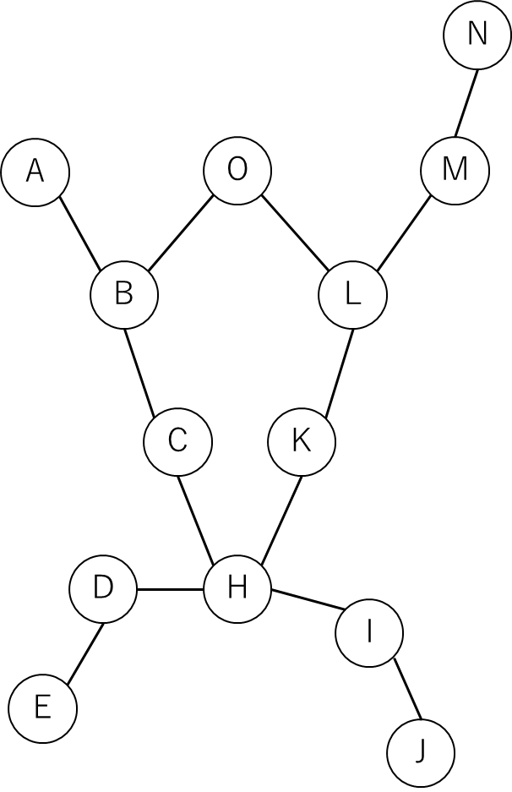
Chapter 2. Quiz
Please traverse below graph using DFS and list nodes by visit order from node (A) with ascending order

Slide 19
Chap. 3 Breadth-First Search
§3 Graphs, Definitions and Representations

Slide 20
Breadth-First Search
Another classical graph-traversal algorithm is breadth-first search (BFS).
BFS visits all successors of a visited vertex before visiting any successors of any of those successors.
This is in contradistinction to the DFS which visits the successors of a visited vertex before visiting any of its “brothers”.
Whereas DFS tends to create very long, narrow trees, BFS tends to create wide, short trees.
Exercise Problem 2 gives a C program for BFS.

Slide 21
Breadth-First Search
Select a vertex v and visit v.
For all edges (v, w), visit the vertices w and put w into a first-in first-out (FIFO) queue.
After w's are visited for all (v,w), we select a vertex w from the FIFO queue, visit all unvisited vertices x for (w,x), and put x into the queue.
v
g
f
v
g
f
w
x
w
x
d
c
e
d
c
e

Slide 22
Breadth-First Search
v
g
f
Repeat the above process until all the vertices in the graph are visited.
w
x
d
c
e
v
g
f
v
g
f
w
x
w
x
visited
d
c
e
d
c
e

Slide 23
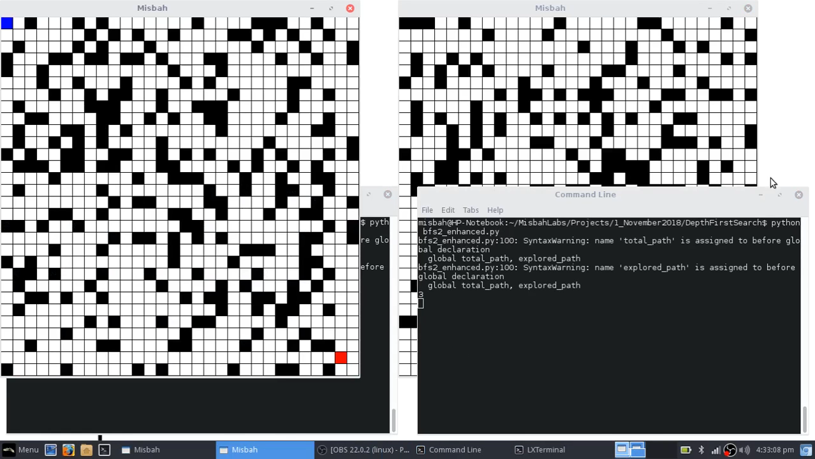

Slide 24
Chapter 3. Quiz
Please traverse below graph using BFS and list nodes by visit order from node (A) with ascending order

Slide 25
Chap. 4 Connectivity of Graphs
§3 Graphs, Definitions and Representations

Slide 26
Connectivity of Graphs
Let G(V, E) be a directed graph.
Two vertices u and v of G is strongly connected if there is a path from u to v and a path from v to u.
A strongly connected component of G is a maximal subgraph of G whose vertices are all strongly connected with each other.

Slide 27
Finding Strong Connected Components
The problem of finding the strongly connected components of G can be done by DFS as follows:
Perform a DFS on G.
To reverse all edges of G creating an inverse graph G_{r}.
A DFS on G_{r} is performed, beginning at the vertex with the lowest label given in the DFS on G.
If this search does not visit all the vertices of G_{r}, the unvisited vertex with the lowest label is chosen and the search is resumed there, carrying on in this way until all vertices of G_{r} have been visited.
G
G_{r}
b
c
b
c
a
d
a
d
f
e
f
e

Slide 28
k-Connected Graph
An undirected graph G is called connected if there is a path between any pair of vertices in G.
G is called k-connected if the removal of any k-1 vertices leaves the remaining subgraph connected.
1-connected is connected;
2-connected (biconnected) means that one vertex failure can be tolerated.
If a graph is connected but not biconnected, it has articulation points: vertices whose removal would disconnect the graph.
e.g.,) The articulation points of the graph are c, e, and f. Articulation points can be found by DFS.
b
d
g
a
c
e
f
h

Slide 29
Articulation Points and Bridges
If a graph is connected but not biconnected, it has articulation points: vertices whose removal would disconnect the graph.
e.g.,) The articulation points of the graph are c, e, and f. Articulation points can be found by DFS.
Bridge: If an edge in a connected graph will be reduce, that connected graph becomes separate (disconnected).
b
d
g
a
c
e
f
h

Slide 30
How to Find Articulation Points and Bridges?
DFS: one of the good solution
Bridges: Traverse from a DFS root, then we can extract “lowlink”.
low[v] is the lowest reachable node ID from the node v. If an edge uv is bridge: ord[u] < low[v]
Articulation Points:
If DFS root is an articulation points: degree k > 1
If any verse u is an articulation points without DFS root: ord[u] ≦ low[v] if u has child v
b
d
g
lowlink
lowlink
lowlink
a
c
e
f
h

Slide 31
Chapter 4. Quiz
Please find all articulation points and bridge from a graph:
J
I
B
A
C
H
G
D
E
F

Slide 32

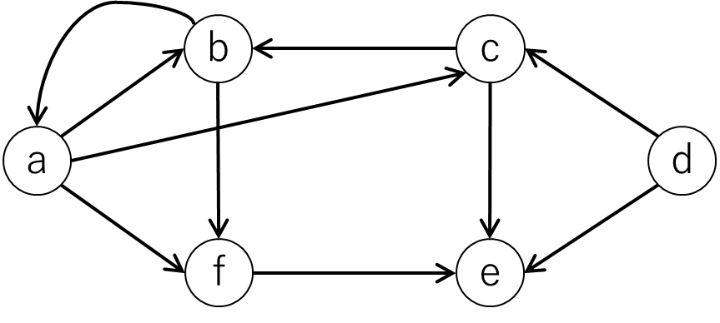
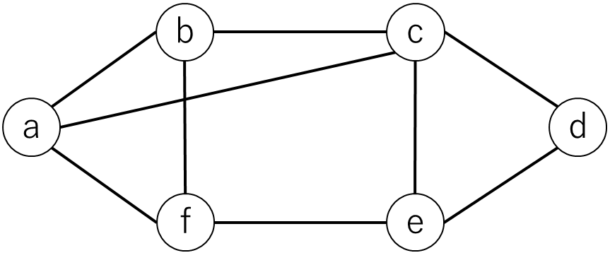
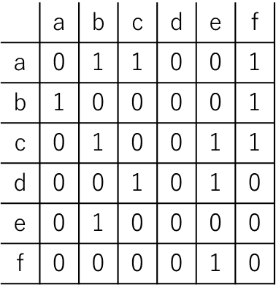
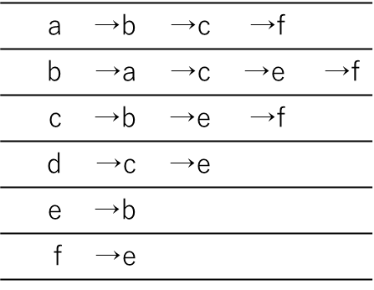
Wrap up today’s class
Graphs: Directed Graph / Undirected Graph
Connection: Path, Cycle, Adjacent
Expression for Adjacent: Matrix, List
Depth-First Search: narrow, long tree
Breadth-First Search: wide, short tree
Strong connectivity: DFS can find
k-Connected: How much connected from a vertex
Articulation Point: DFS can find

